Slide 1
Pauline Gagnon, Indiana University/CERN
How can we draw more women to physics

Slide 2
Outline
Some statistics from ATLAS and CERN
Easy things to do to improve the situation

Slide 3
ATLAS Collaboration: 38 countries, 3000 people

Slide 4
Fraction of women in ATLAS as on October 2012
Based on qualified authors
(after 1 year of service work)
1952 scientific authors:
389 women
19.9% women (was 15.6% in May 2008)
below the age of 36:
50% of all women; 33% of all men
of all ATLAS authors:
above the age of 50: 12% are women
above the age of 36: 16% are women
below the age of 30: 30% are women
Many young women are joining ATLAS

Slide 5
% of women by affiliation and nationality
country of affiliation | % in ATLAS by affiliation | % of women by affiliation | % of women by nationality
USA | 18,2% | 16,1% | 11,3%
Germany | 13,9% | 20,7% | 15,2%
UK | 10,1% | 23,2% | 18,1%
Italy | 7,7% | 25,8% | 31,9%
France | 7,0% | 29,2% | 23,6%
Russia | 5,1% | 5,1% | 6,1%
Japan | 4,1% | 4,9% | 7,5%
Canada | 3,8% | 20,0% | 22,2%
Spain | 2,9% | 35,7% | 35,6%
Czech | 2,5% | 6,3% | 8,9%
Netherland | 1,9% | 27,0% | 11,1%
Sweden | 1,8% | 25,7% | 26,7%
country of affiliation | % in ATLAS by affiliation | % of women by affiliation | % of women by nationality
China | 1,7% | 5,9% | 12,0%
Israel | 1,6% | 18,8% | 19,2%
Switzerland | 1,4% | 25,9% | 16,0%
Greece | 1,3% | 34,6% | 40,5%
Poland | 1,2% | 30,4% | 31,3%
Norway | 0,9% | 27,8% | 28,6%
Portugal | 0,9% | 22,2% | 20,8%
Romania | 0,8% | 46,7% | 42,9%
Australia | 0,7% | 7,1% | 0,0%
Turkey | 0,7% | 21,4% | 26,3%
Denmark | 0,6% | 16,7% | 9,1%
Brazil | 0,5% | 30,0% | 23,1%

Slide 6
Women on ATLAS per country of affiliation above ATLAS average in 2012
Country of affiliation | # women | % women
Romania | 7 | 46,7%
Spain | 20 | 35,7%
Greece | 9 | 34,6%
Poland | 7 | 30,4%
France | 40 | 29,2%
Norway | 5 | 27,8%
Netherland | 10 | 27,0%
Switzerland | 7 | 25,9%
Italy | 39 | 25,8%
Sweden | 9 | 25,7%
UK | 46 | 23,2%
Portugal | 4 | 22,2%
Germany | 56 | 20,7%
Canada | 15 | 20,0%
Using only countries with > 14 people; these countries = 54% of ATLAS

Slide 7
Country of hire of CERN Users

Slide 8
% of women physicists at CERN by end of 2012
physicists | men | women | % women
CERN staff | 71 | 8 | 10.1%
Users | 9217 | 1602 | 17.4%
Low fraction for CERN partly explained by the lack of graduate students
Summer Student Program | Member states program |  | Non-member states program
 | applied | admitted | applied | admitted
2009
2010 | 21% | 27% | 23% | 30%
2011 | 22% | 31% | 21% | 23%
2012 | 24% | 29% | 21% | 26%
2013 | 25% | 28% | 23% | 31%

Slide 9
Are women less apt at physics than men? http://www.sciencemag.org/content/314/5799/599.full
Metadata studies summarizing >5000 individual studies, based on the testing of ~7 million people.
Using d statistics: d = (M_{M} − M_{F})/s_{w}, where M_{M} is the mean score for males, M_{F} is the mean score for females, and s_{w} is the combined standard deviation
The d statistic measures the distance between male and female means, in standard deviation units.
78% of the effects for psychological gender differences were small or near zero
mathematics problem-solving, d = 0.08
leadership effectiveness, d = −0.02
Emphasis on gender differences in the popular literature reinforces stereotypes that girls lack mathematical and scientific aptitude
To neutralize traditional stereotypes about girls' lack of ability and interest in mathematics and science, we need to increase awareness of gender similarities
Rather than focusing on gender differences mathematics and science educators would profitably examine ways to increase awareness of the similarities in performance and in ability to succeed

Slide 10
What’s the best way to attract more women in physics?
Great study from Harvard (PRiSE study)
http://blogs.scientificamerican.com/guest-blog/2011/03/29/can-we-declare-victory-for-women-in-their-participation-in-science-not-yet/
Students who pursue studies in physics need a strong “physics identity”
This is true for both male and female students, but female students tend to believe in themselves less, contributing to the difficulties they can encounter in physics.

Slide 11
What is a strong “physics identity”?
“Physics identity" is the degree to which students perceive themselves to be the right type of person for physics.
having confidence in their ability to complete the right tasks (for example, understand and solve difficult physics problems)
having a strong interest in physics
having others recognize them as the right type of person
being successful in physics
choosing to participate in physics-related activities.
Students with a strong physics identity are more likely to remain in physics and pursue it as a career.

Slide 12
What helps build a strong “physics identity”
Students liked
Having opportunities for peer teaching
Receiving encouragement from teachers
Discussing in class about the benefits of being a scientist
Teachers should:
Discuss current and cutting-edge physics topics
Encourage student questions
Set up labs addressing students’ beliefs about the world

Slide 13
What about women in particular?
The Prise study researchers found that the following experiences had no real effect on building a strong physics identity for young girls
providing positive female science role models
creating opportunities for collaborative group work
discussing the lives of female scientists.

Slide 14
Discussing the under-representation of women in science makes a huge difference
Not just highlighting women scientists like Marie Curie but instead talking directly about the fact that there are few women in physics
Talking about it helps young women see the problem comes from society, not from them
Female students who had these discussions in high school had significantly stronger physics identities
These discussions had no adverse impact on young men

Slide 15
Conclusions of one author of the Prise study
Social influences are still very important for determining if students will pursue a career in physics.
Student’s opinions are far from fixed, and good science teachers can have an important effect on their students’ physics identities.
Most importantly, teachers who did something as simple as acknowledging the gender imbalance in physics could be enough to help encourage female students toward a physics career.

Slide 16
Recommendations from young women physicists http://www.quantumdiaries.org/2013/04/03/how-to-attract-hire-and-retain-more-women-in-science/
To attract more women:
Fight gender stereotypes at all levels
Help young people build a strong “physics identity”
Provide role models and mentors for young women
To hire more women:
Implement anonymous job application processes
Implement equitable parental leaves
Add spousal considerations to hiring processes
To retain more women:
Provide mentors for young women starting their careers
Have broad discussions about gender issues at large scientific meetings
Hold scientific meetings for women

Slide 17
Fight stereotypes at all levels
improve the representation of women in textbooks
include female characters in the phrasing of problems
A study showed women score higher
increase the visibility of women scientists in the general culture by providing more female contacts for the media
use gender-neutral language when referring to scientists or specify both genders

Slide 18
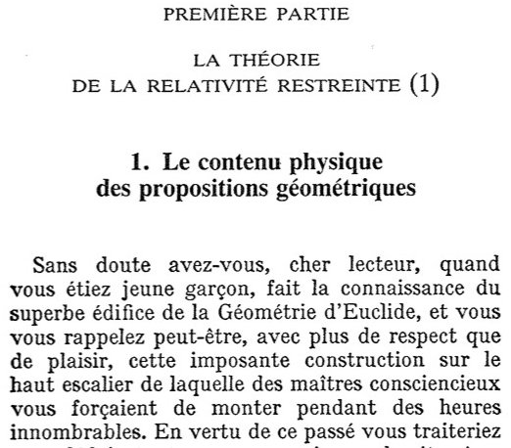
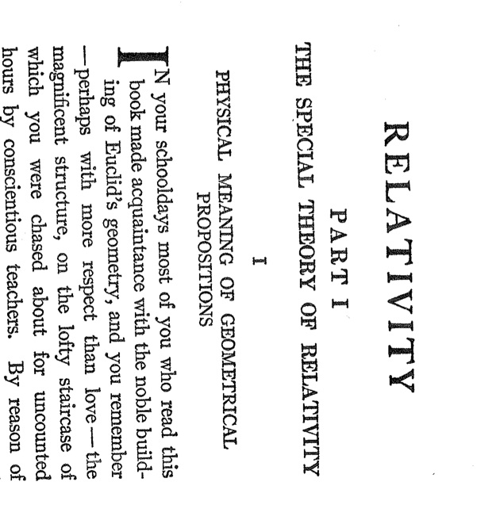
Using non-sexist language
Introduction to Einstein’s book on relativity:
the English and French translations and the original in German

Slide 19
Provide role models and mentors for young women
Do it at all stages.
Hold career fairs to reinforce girls’ self-esteem and provide a context where they can discuss with other girls facing similar challenges
Provide places where young women can talk with peers and find support.

Slide 20
Conclusion
The number of women in physics and HEP is increasing
Reinforcing “physics identity” helps recruiting more young women but also more young men.
Discussing the poor representation of women in physics helps strengthening “physics identity”
There are many ways to improve the situation: talking about it is already a good step

Slide 21
Remember: everything that is good for women is good for everyone
All what I have said is also good for other under-represented groups
Having a more diverse community means tapping into more potential

