Slide 1

What does a Higgs boson eat during the winter
…and other essential details
Pauline Gagnon, CERN et Indiana University
Physicist on ATLAS experiment and communicator

Slide 2
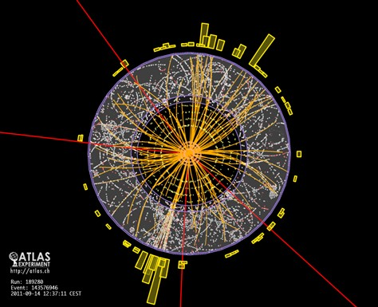
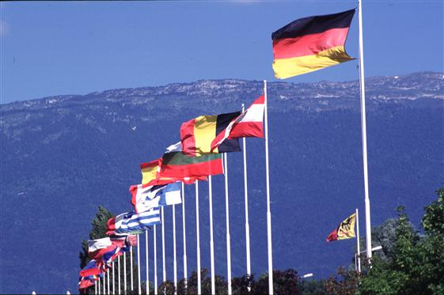
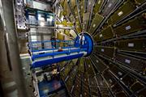
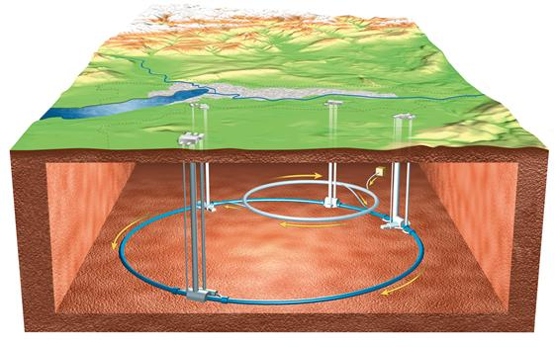
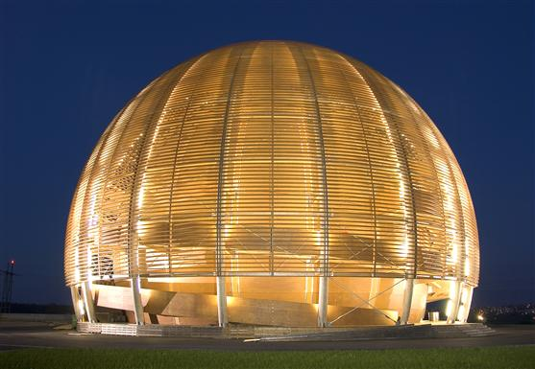
CERN
European Laboratory for Particle Physics
12000 scientists of 99 different nationalities
Financed by European countries
Many other countries participate in various projects
  Canada, United States, Japan, Israel, India, Pakistan etc.
Common goal: find out what matter is made of

Slide 3
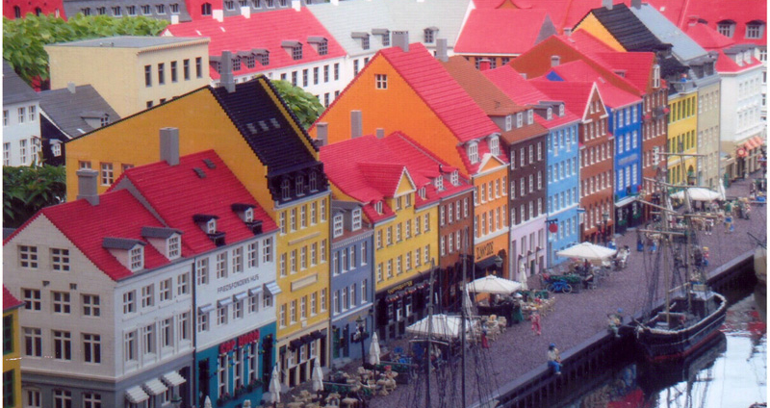
The Legoland version of Copenhagen

Slide 4
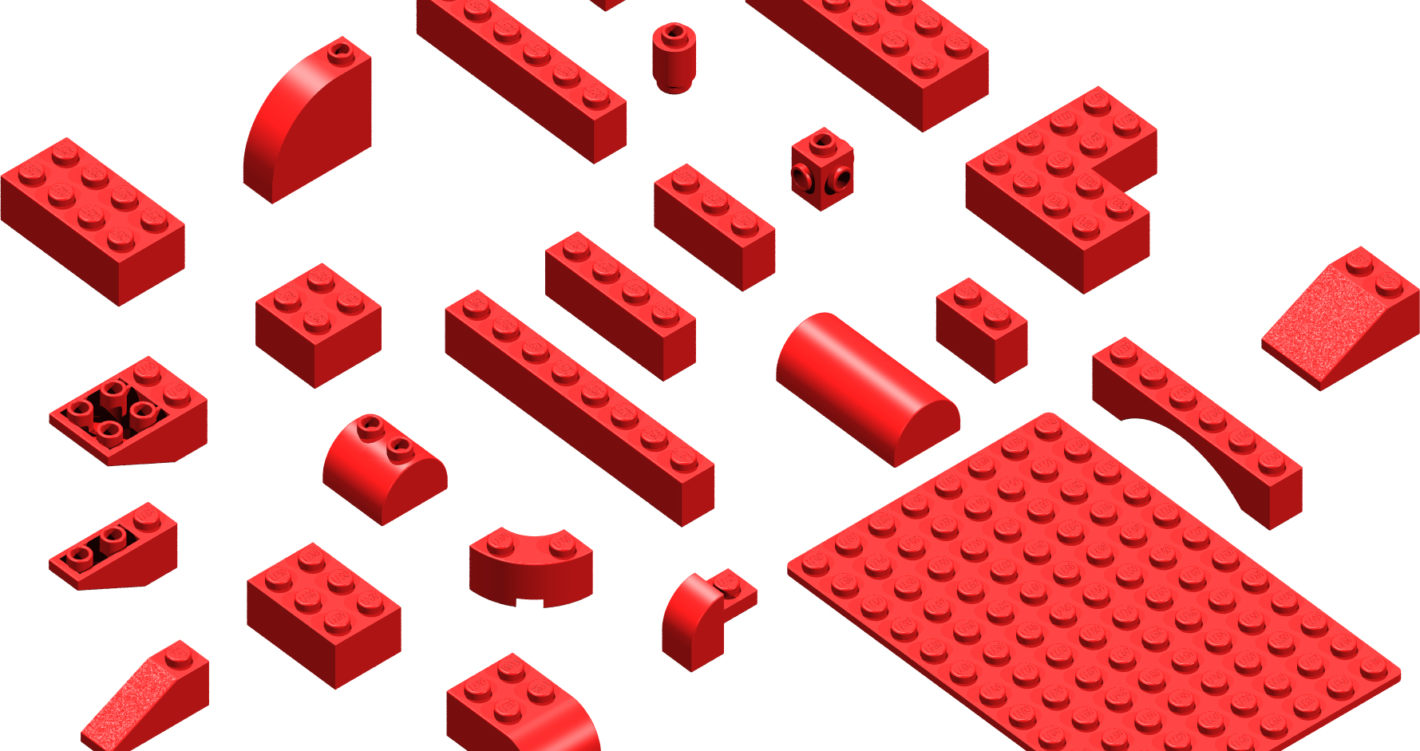
At Legoland, here is what fundamental particles look like

Slide 5
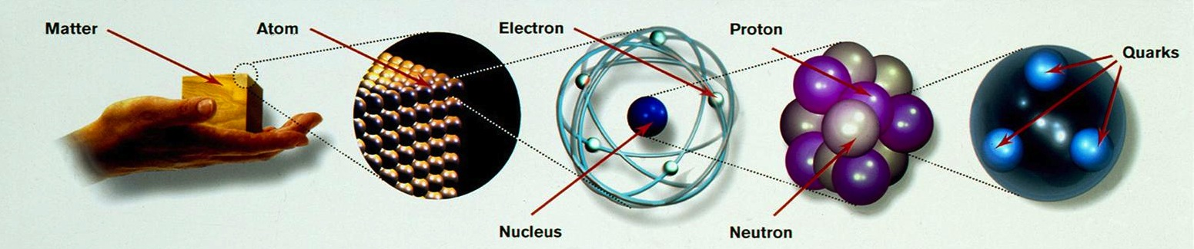
What are the smallest building blocks of matter?
The only fundamental particles here are electrons and quarks

Slide 6




Protons and neutrons are made of quarks
Up : (charge +2/3) and down quarks: (charge -1/3)
Proton: up up down proton
+2/3 +2/3 -1/3 = +1
+ + =
  Neutron: up down down neutron
+2/3 -1/3 -1/3 = 0
+ + =

Slide 7
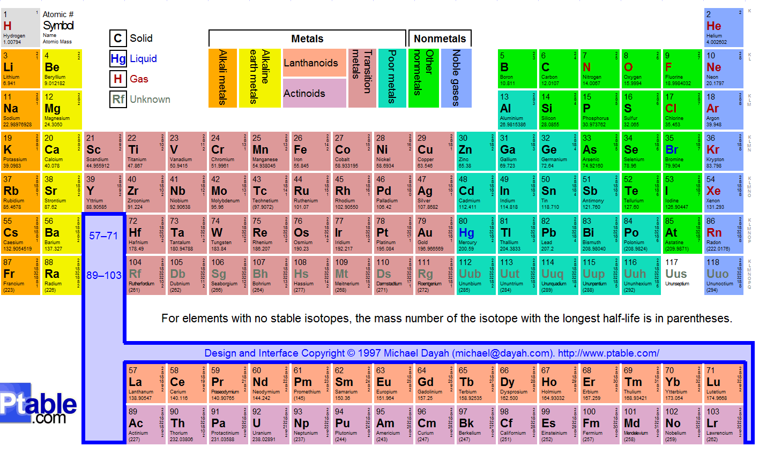
That’s all you need to form all elements

Slide 8




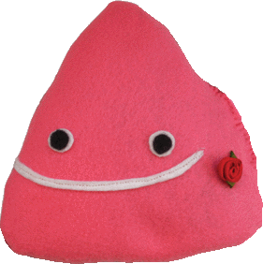






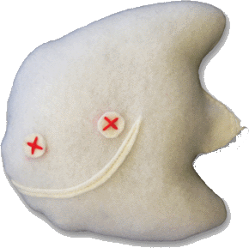



The Standard Model
All matter is made of fundamental particles
LEPTONS
S
QUARKS
Ordinary
matter
ELECTRON
ELECTRON
NEUTRINO
UP
DOWN
MUON
MUON
NEUTRINO
CHARM
STRANGE
TAU
TAU
NEUTRINO
TOP
BOTTOM
Exchange particles called bosons are associated to forces
GLUONS
Strong interaction
PHOTONS
Electromagnetism
W and Z BOSONS
Weak interaction
GRAVITONS
Gravitation
HIGGS
Brout-Englert-Higgs field
?
www.particlezoo.net

Slide 9
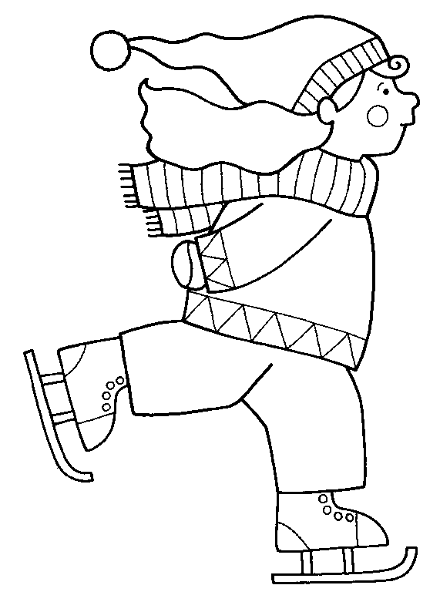

Particles interact by exchanging other particles

Slide 10




Major problem with the equations
The Standard Model only predicted massless particles
But we knew that the W⁺, W⁻ and Z⁰ bosons had a mass
    massless photon + massive bosons
How could the equations of the Standard Model generate massive particles?

Slide 11
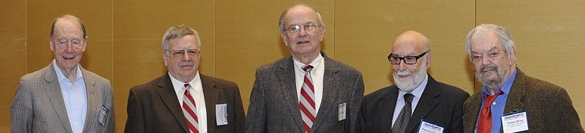
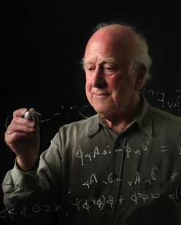
Modify the equations of the Standard Model
In 1964, several theorists proposed a mecanism that would explain how particles could acquire mass
Tom Kibble, Gerald Guralnik, Carl Hagen, François Englert, Robert Brout, Peter Higgs

Slide 12
To generate mass, we need:
The Brout-Englert-Higgs mechanism
  A mathematical description
The Higgs field
  A real physical entity corresponding to this mechanism
The Higgs boson
  The materialisation or proof of existence of all that

Slide 13


The Brout-Englert-Higgs mechanism
Theory predicted 4 massless bosons
The Brout-Englert-Higgs mechanism breaks this symmetry by remixing everything after injecting 3 fictitious particles
 | Mass in GeV | Electric charge
photon | 0 | 0
W⁺ | 80.4 GeV | +1
W⁻ | 80.4 GeV | -1
Z⁰ | 91.2 GeV | 0

Slide 14
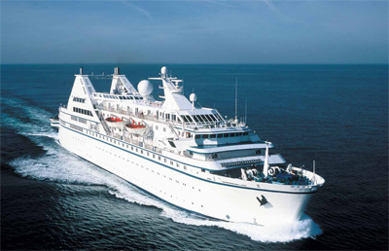
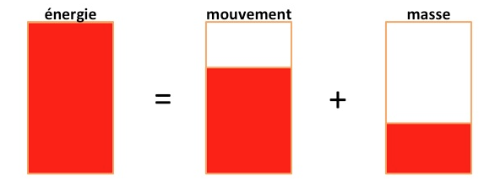
Mass
In physics, mass is
resistance to movement
E= m c ²
Energy and Mass are equivalent
Energy conservation
Energy can take several forms but its sum is always conserved
energy movement mass

Slide 15

With the Higgs field, it is as if the whole space is viscous
The Higgs field
Running on the beach, light and free like air
Then running in water
You get the impression of getting sluggish

Slide 16
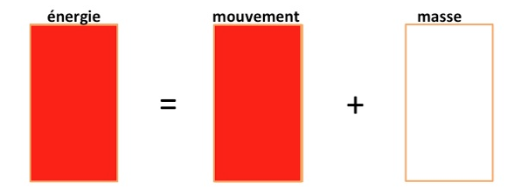
2. How does the Higgs field generate mass
Empty space, without a Higgs field
A
B
energy movement mass

Slide 17
The Higgs field gives mass without dissipating energy
Space with the Higgs field
A
B
energy movement mass

Slide 18
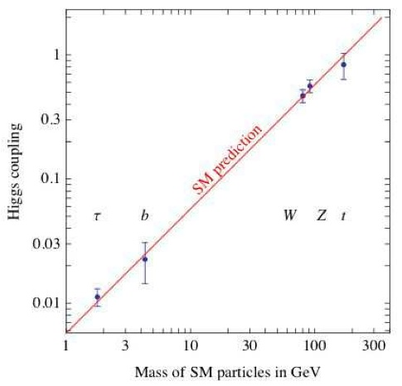
How much mass?
The more a particle interacts with the Higgs field, the more mass it gets
photon

Slide 19
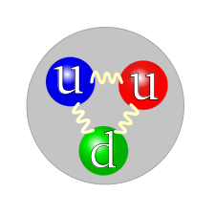
The mass in matter
Quarks mass: 11 MeV
Proton mass: 938 MeV
99% of the proton mass comes from the binding energy given by the gluons

Slide 20

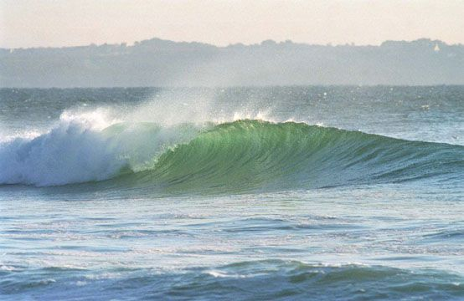
To summarize, there are 3 aspects:
A mathematical tool:
The Brout-Englert-Higgs mechanism:
Z⁰ and W± get a mass but not photons
A physical entity:
The Higgs field filled all space shortly after the Big Bang
An excitation of the field:
The Higgs boson

Slide 21
The Higgs boson
The Higgs field ➔ the surface of the ocean
The Higgs boson ➔ a wave
Waves are excitations of the ocean surface
We can create Higgs bosons by exciting the Higgs field

Slide 22
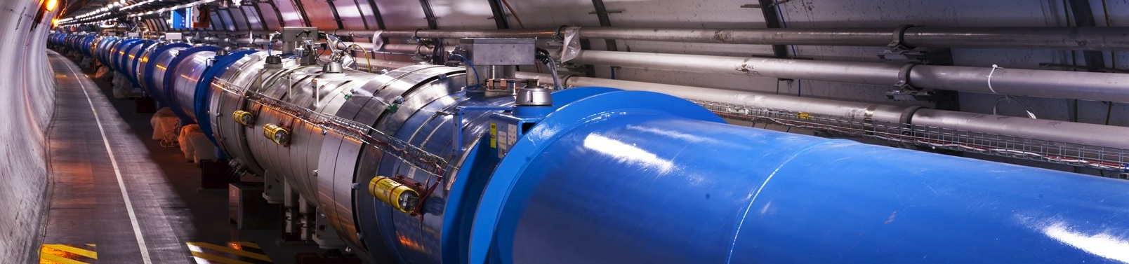
How can we create a Higgs boson?
We need to concentrate a huge amount of energy in a small point in space – that’s the role of the LHC

Slide 23
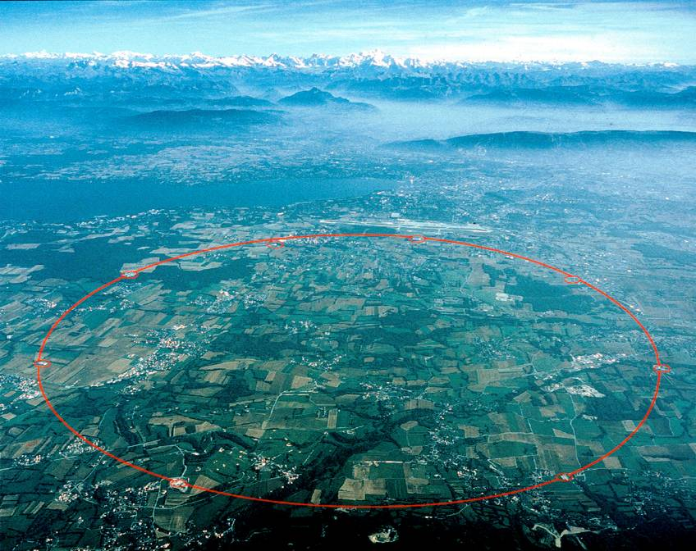
The Large Hadron Collider (LHC)

Slide 24
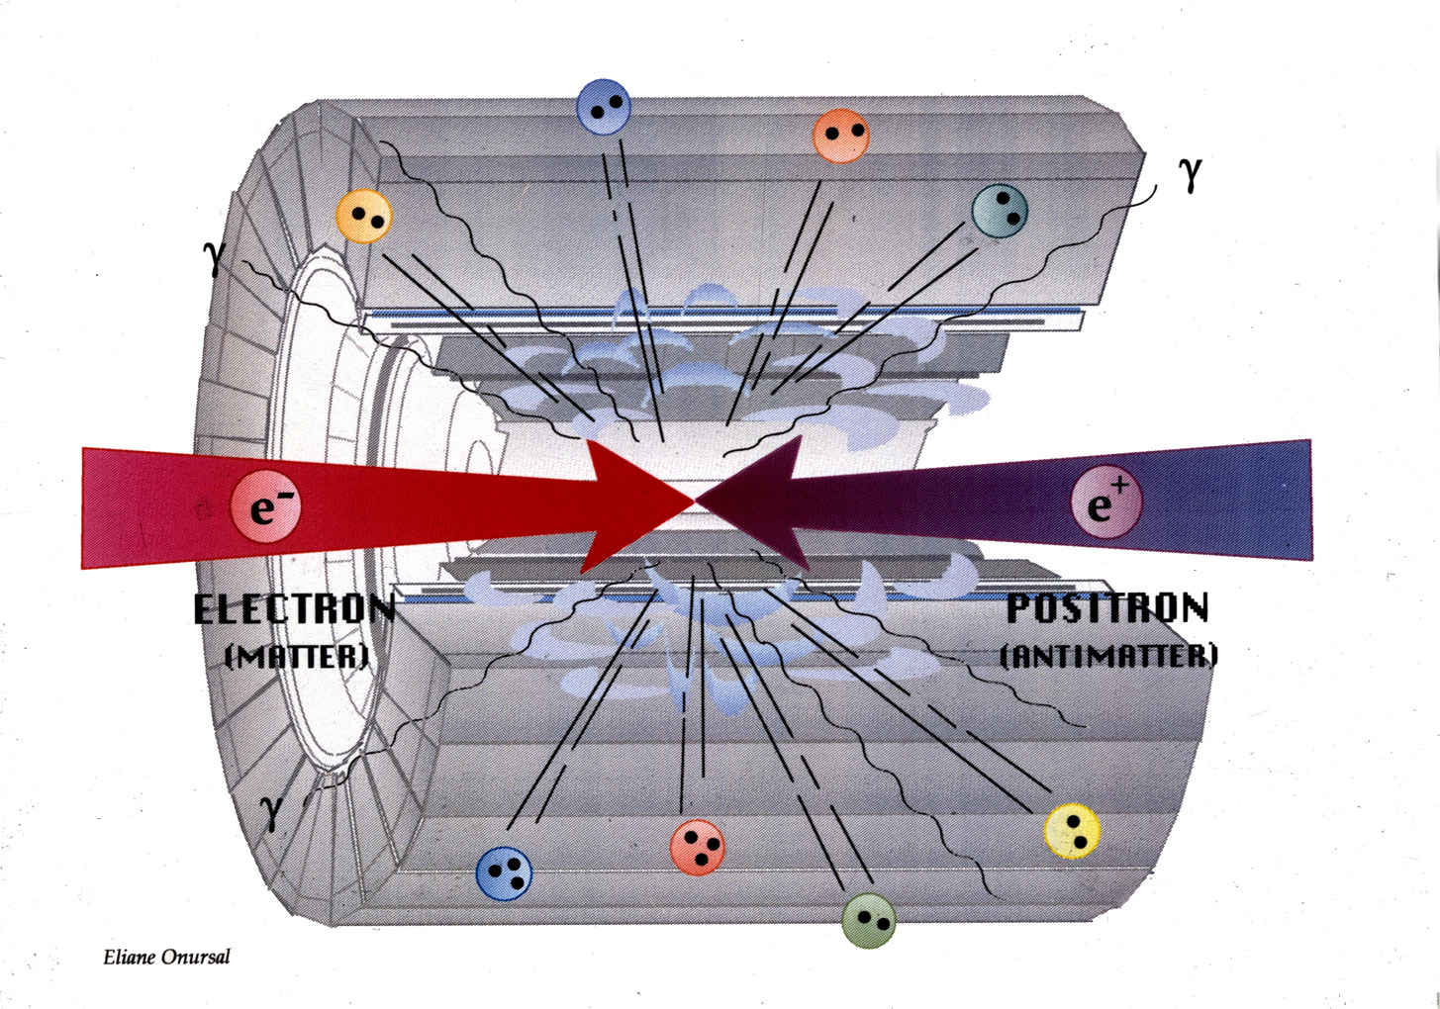
The energy released during the collisions materialises to create particles:
E=mc²
p
p
proton
proton

Slide 25


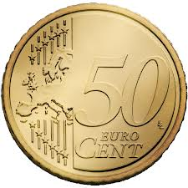
Decay of a Higgs boson
Higgs Z boson + Z boson muon + muon + muon + muon
Z boson + Z boson muon + muon + muon + muon

Slide 26
H → ZZ or ZZ ? Each Z → μμ
μ
μ
μ
μ

Slide 27


Slide 28
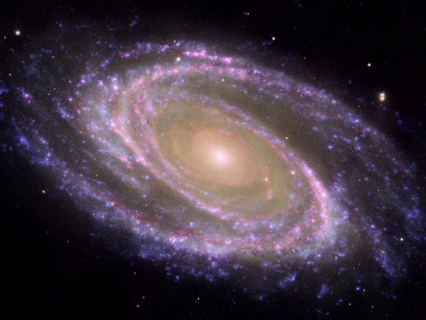
Dark matter mystery

Slide 29
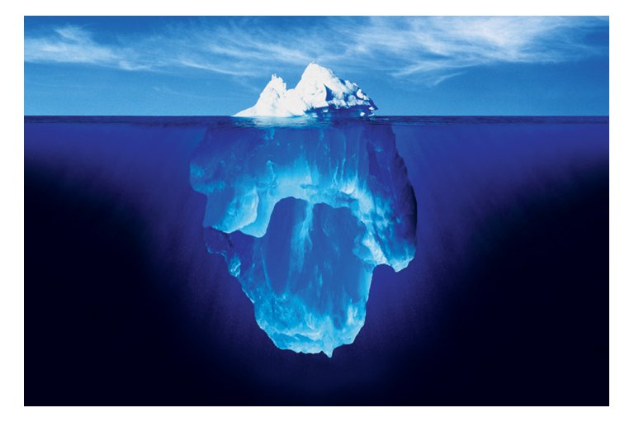
?

Slide 30
Thank you for your attention
You can follow my Blogs on Quantum Diaries
http://www.quantumdiaries.org/author/cern/
Pauline.Gagnon@cern.ch

Slide 33
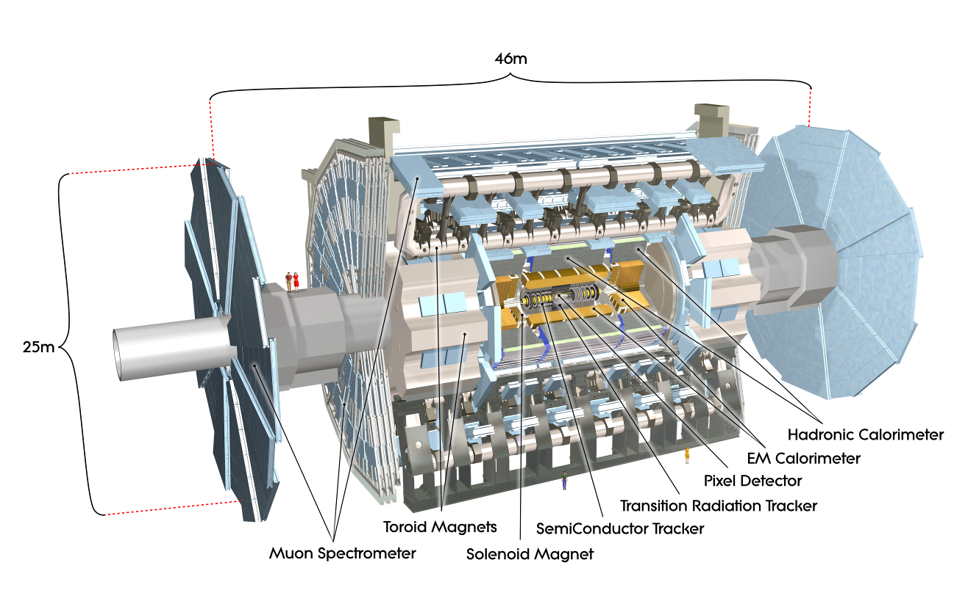
The ATLAS detector: a giant camera

Slide 34
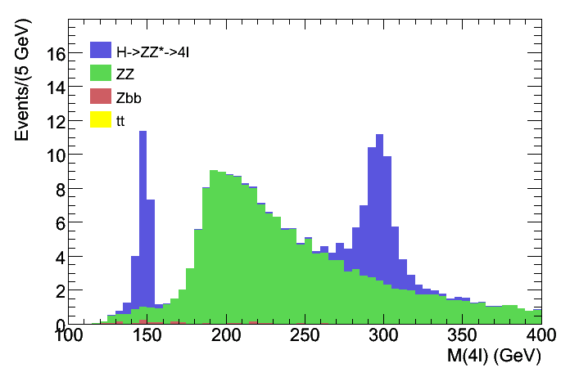
How to distinguish an event containing a Higgs boson from all other events?
H → ZZ* → 4l
m_{H} = 130 GeV
# of events
combined mass (GeV)

Slide 35
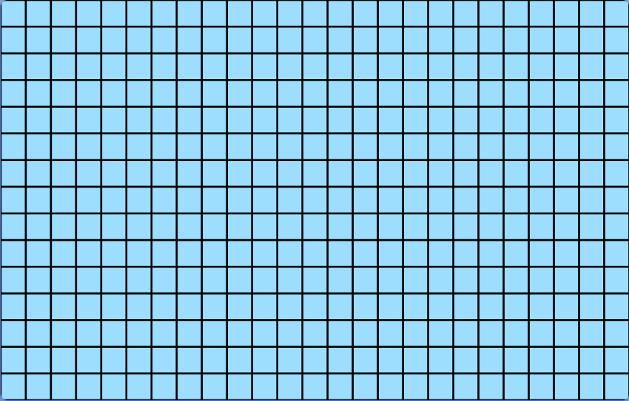
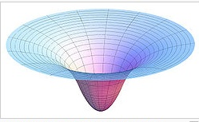
Example: The gravitational field
In empty space:
space-time is uniform
light travels on a straight line
We do not see the gravitational fied but it affects everything, including light, passing near by

Slide 36
Great discovery
Without the Brout-Englert-Higgs mechanism, there was no way to explain the origin of mass
Without mass, all particles would travel at the speed of light
There would be no matter
We now have a complete theory that explains nearly everything

